Slide 1
Microbiome Data Analysis
Baylor Fiber Study: Pilot Prebiotin Intervention

Slide 2
Overview of compliance by group – stool collection
Placebo Group (n=6)
Week 1 – all 6
Week 4 – all 6
Week 8 – 3/6
Week 12 – 5/6
Intervention Group (n=5)
Week 1 – all 5
Week 4 – 4/5
Week 8 – 4/5
Week 12 – 4/5
Note: One subject has a duplicate Week 12 sample – it looks obvious which one is correct out of the 2

Slide 3
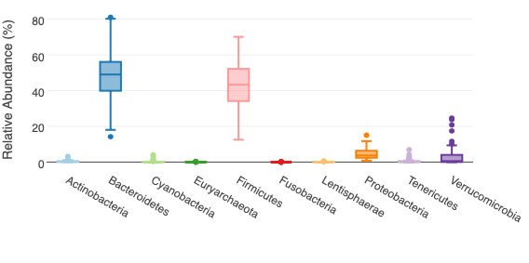
Data Checking – Phylum relative abundance

Slide 4
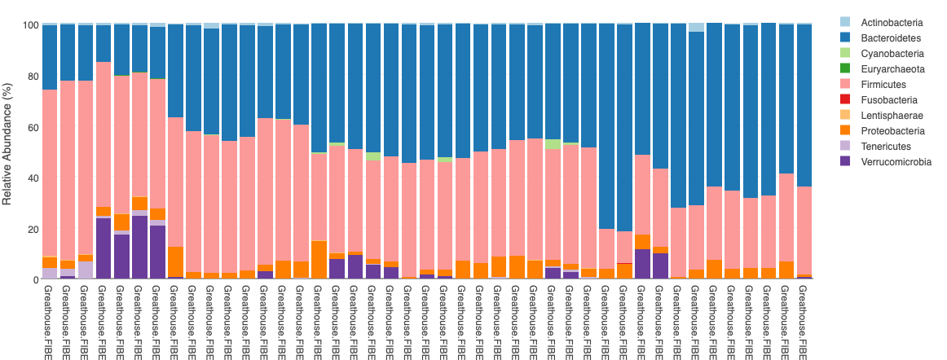
Data Checking – Phylum distribution

Slide 5
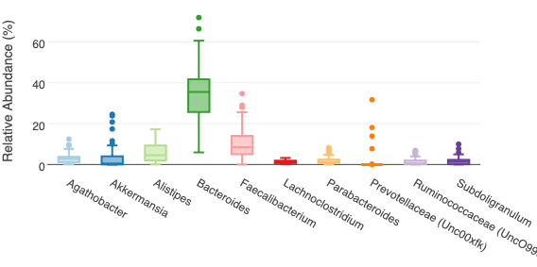
Data Checking – Genus relative abundance

Slide 6
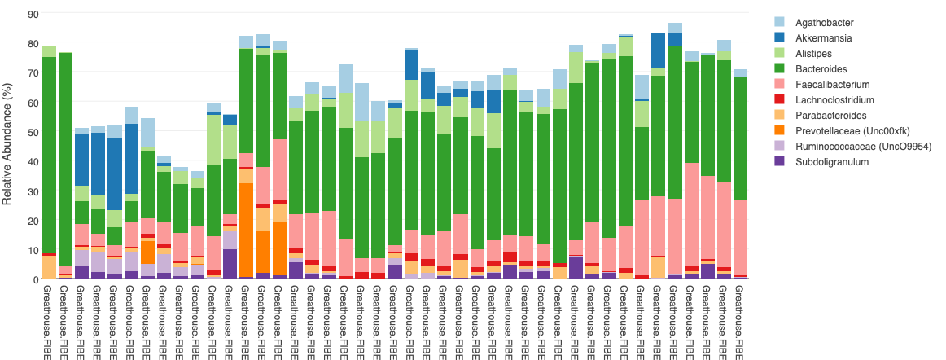
Data Checking – Genus distribution

Slide 7
Genus relative abundance by intervention at study end point

Slide 8
Phylum relative abundance by intervention

Slide 9
Genus relative abundance by intervention

